Slide 1

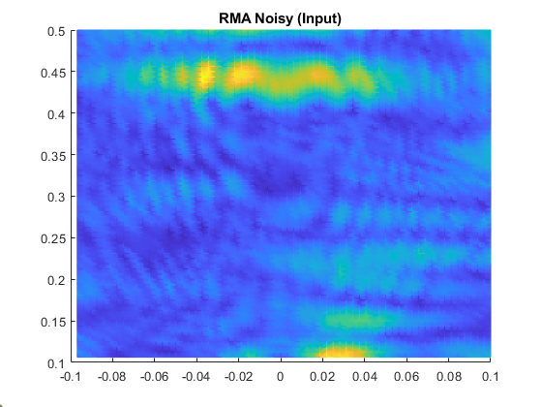


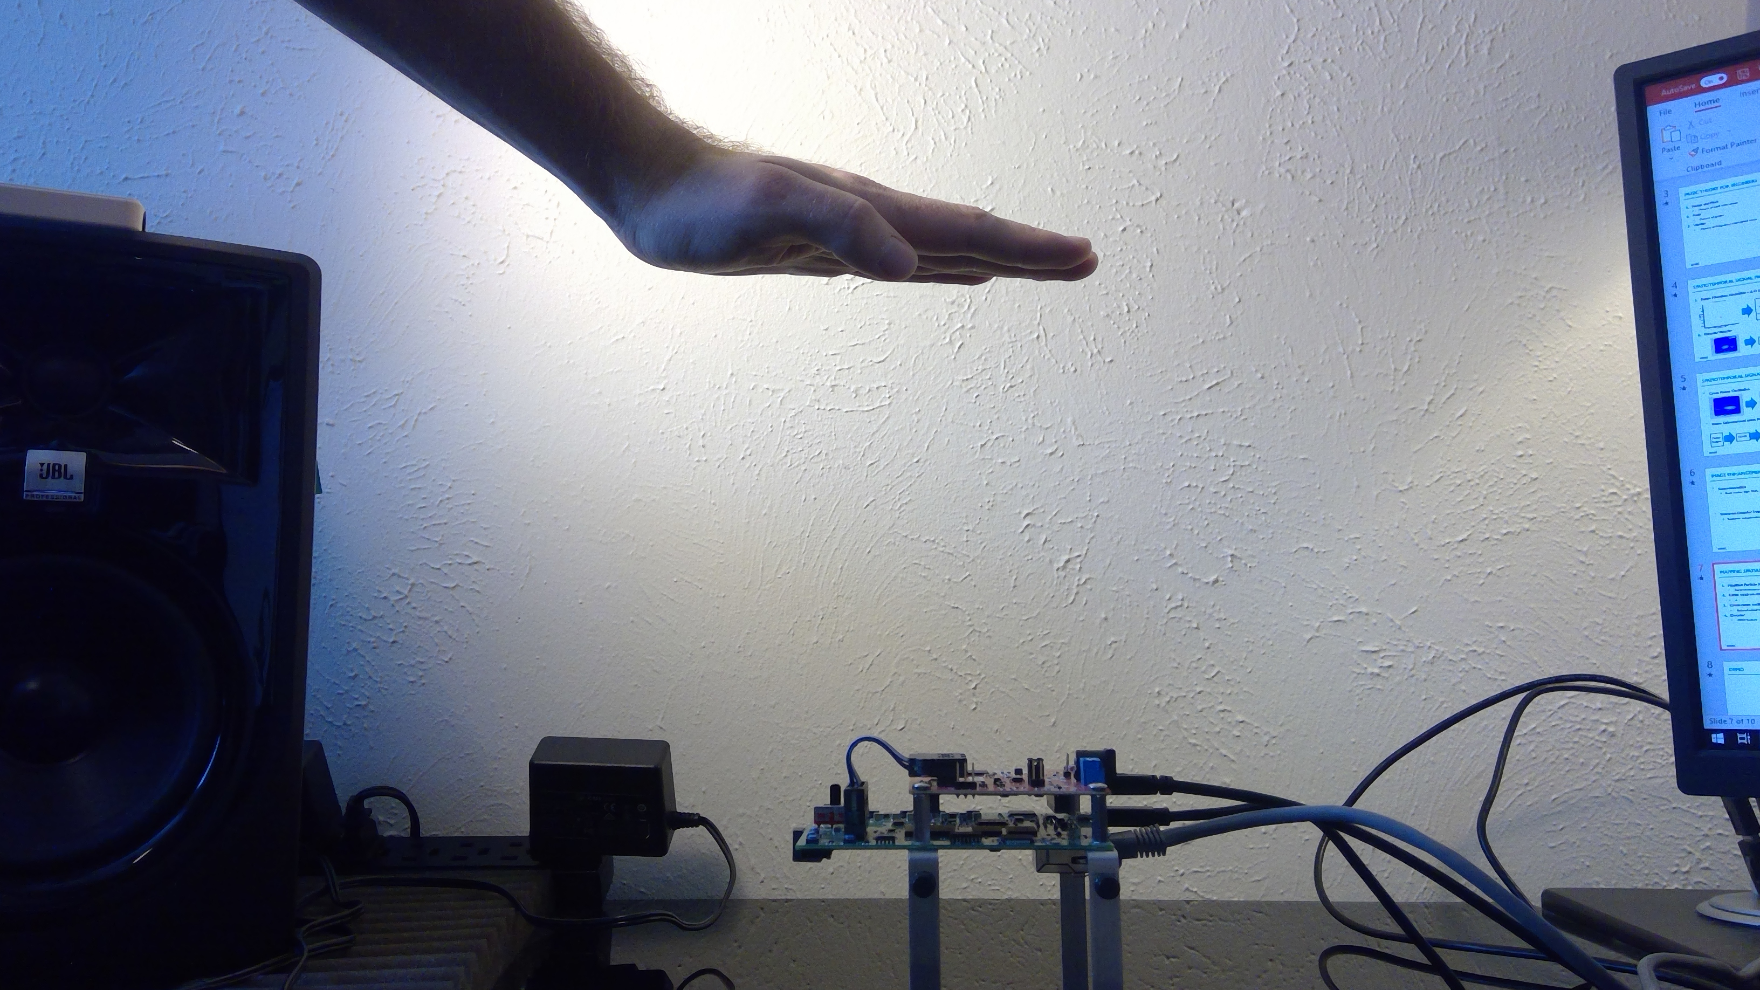
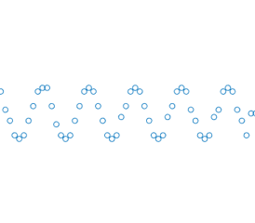
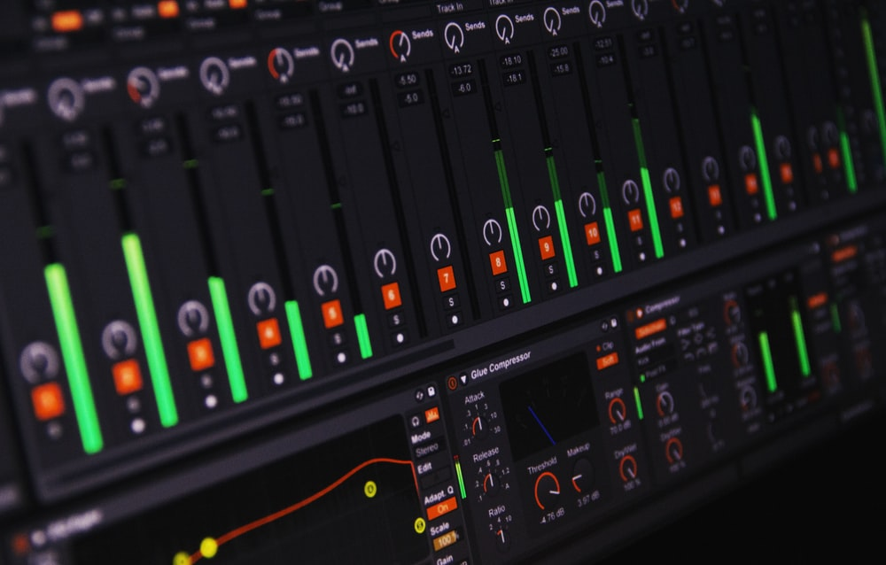
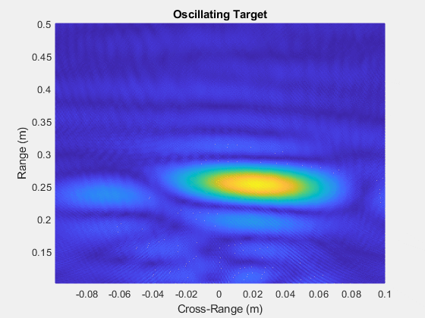
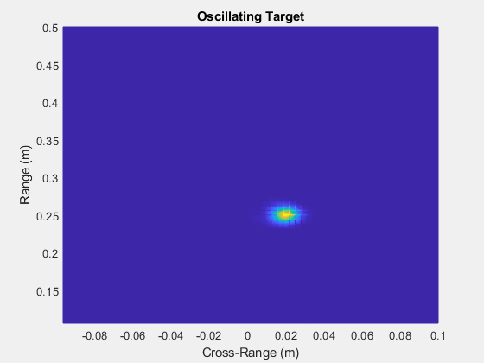
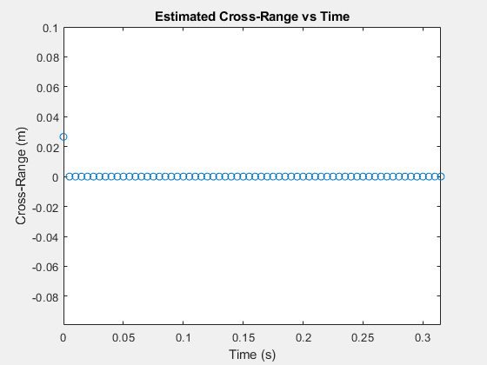
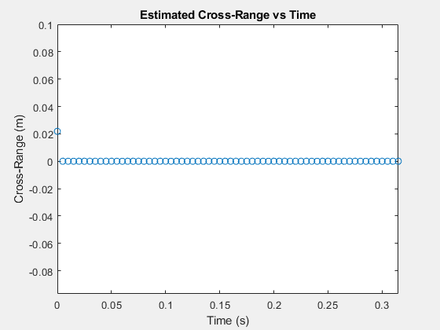
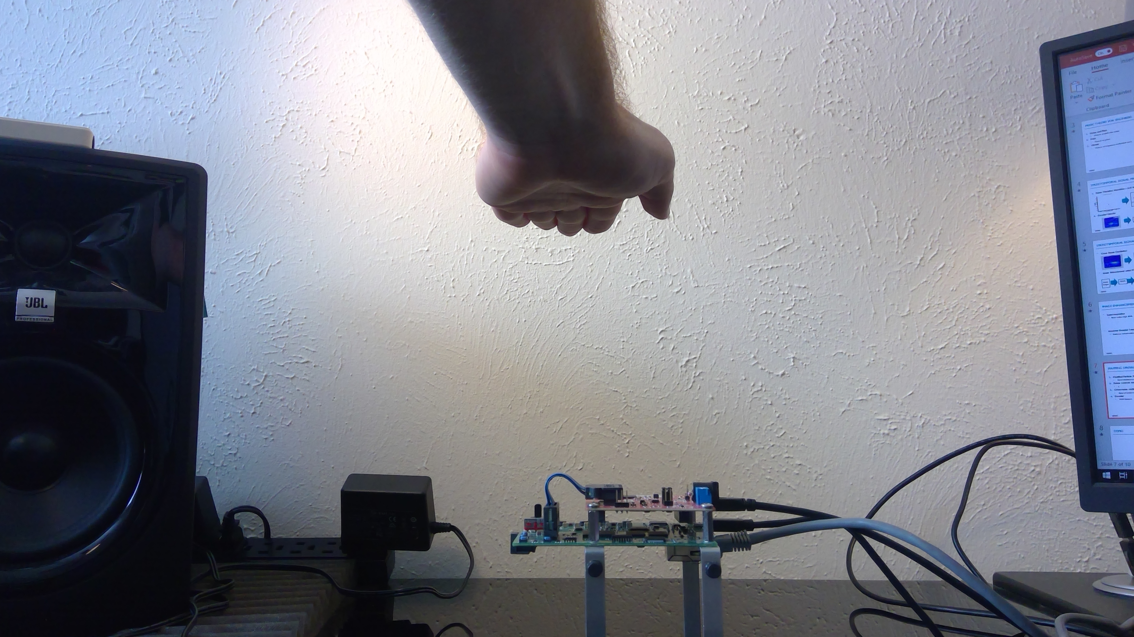
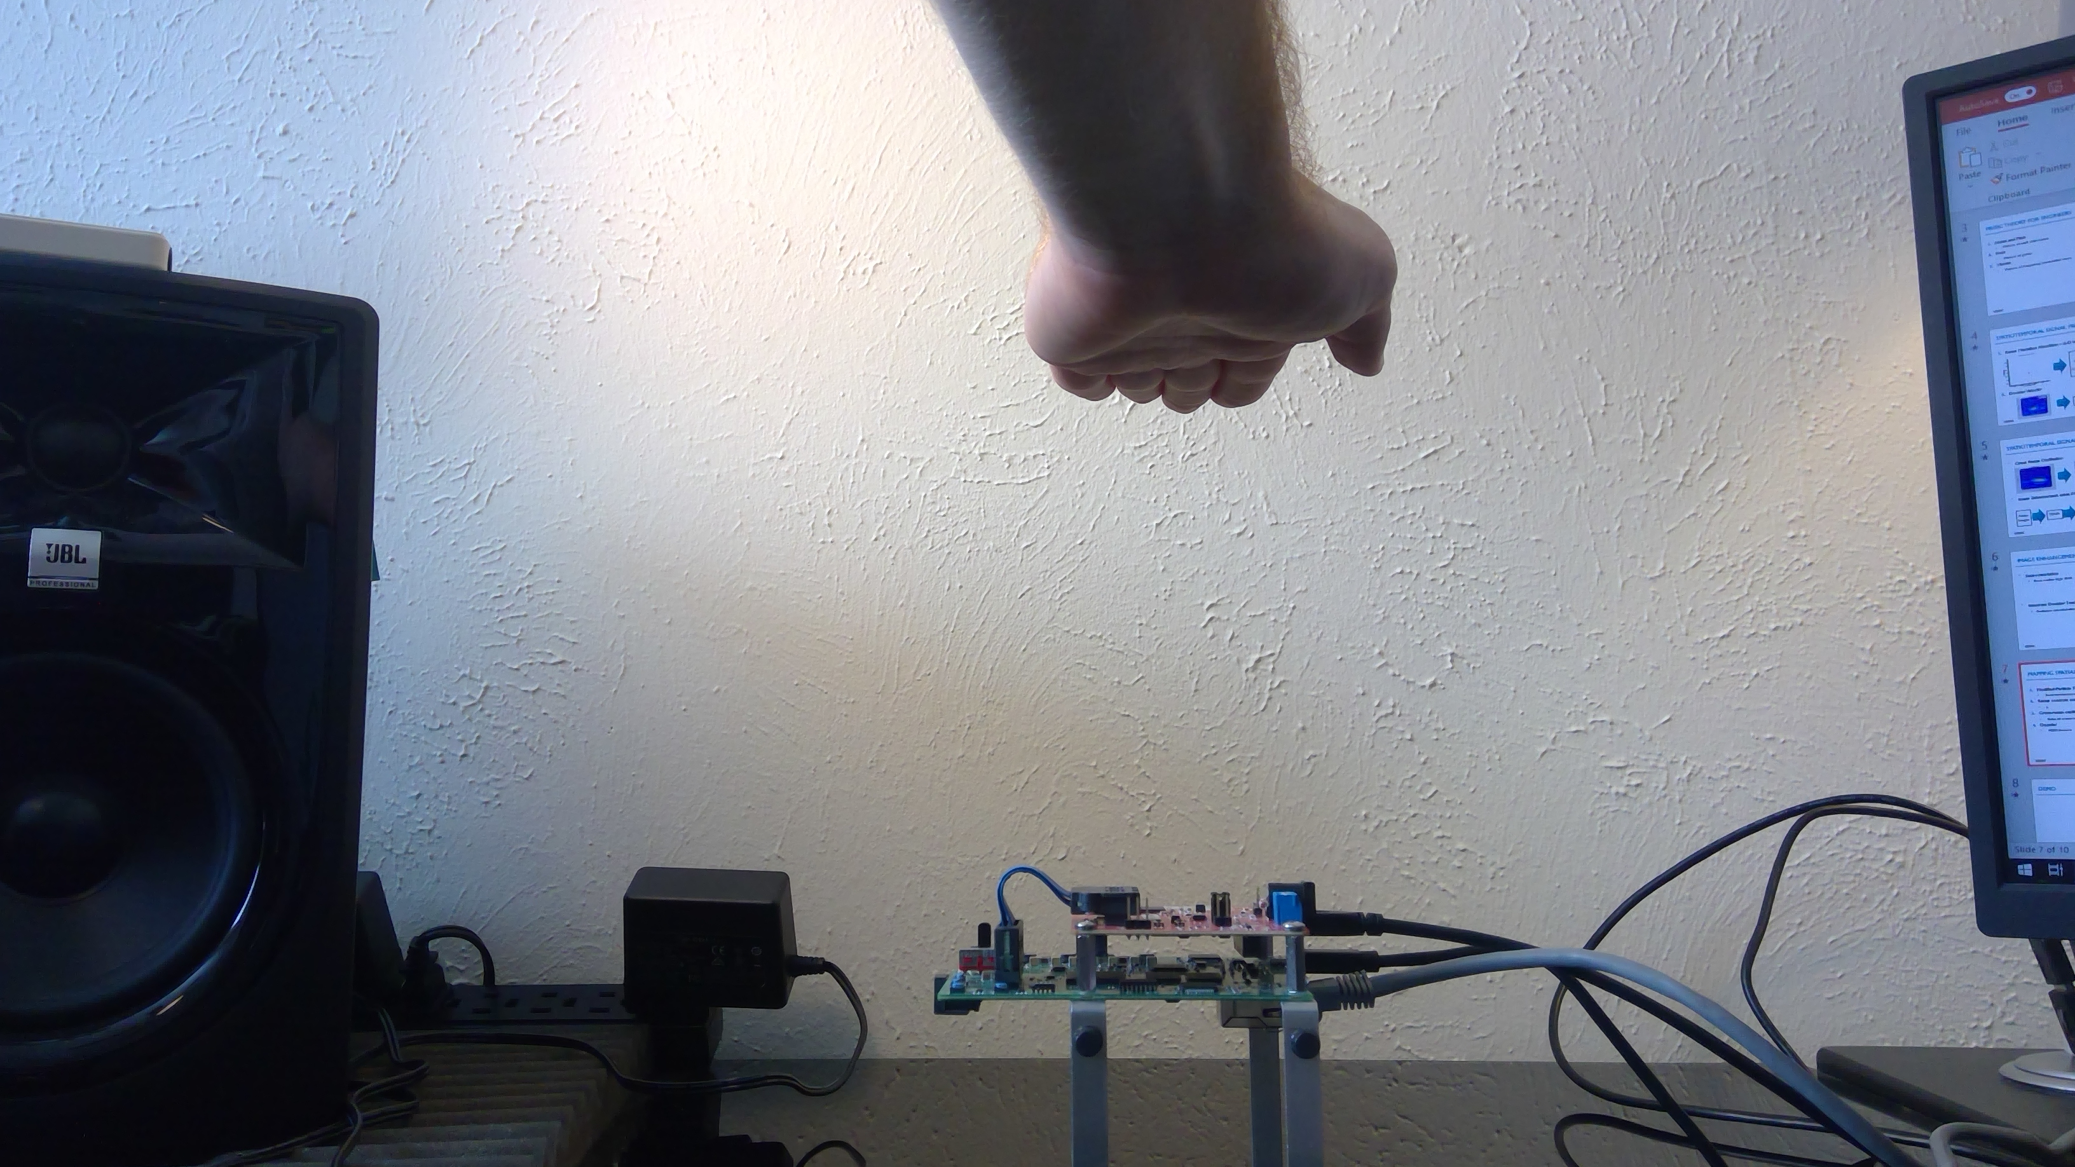
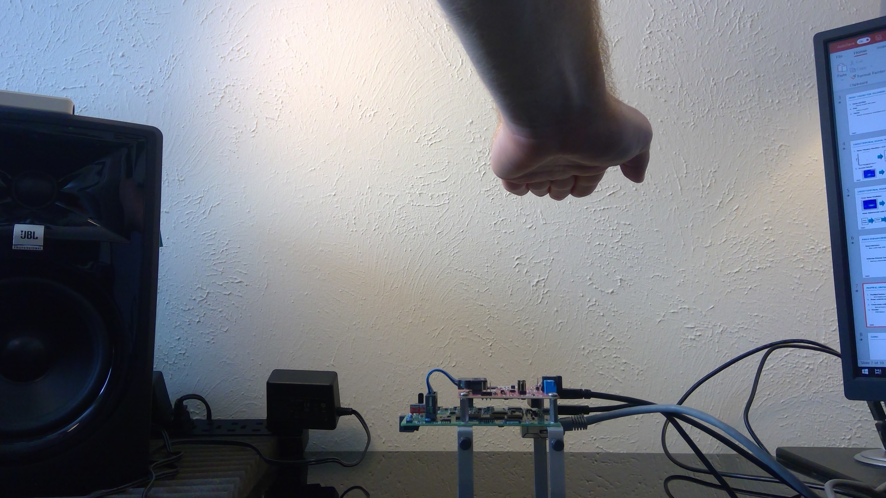
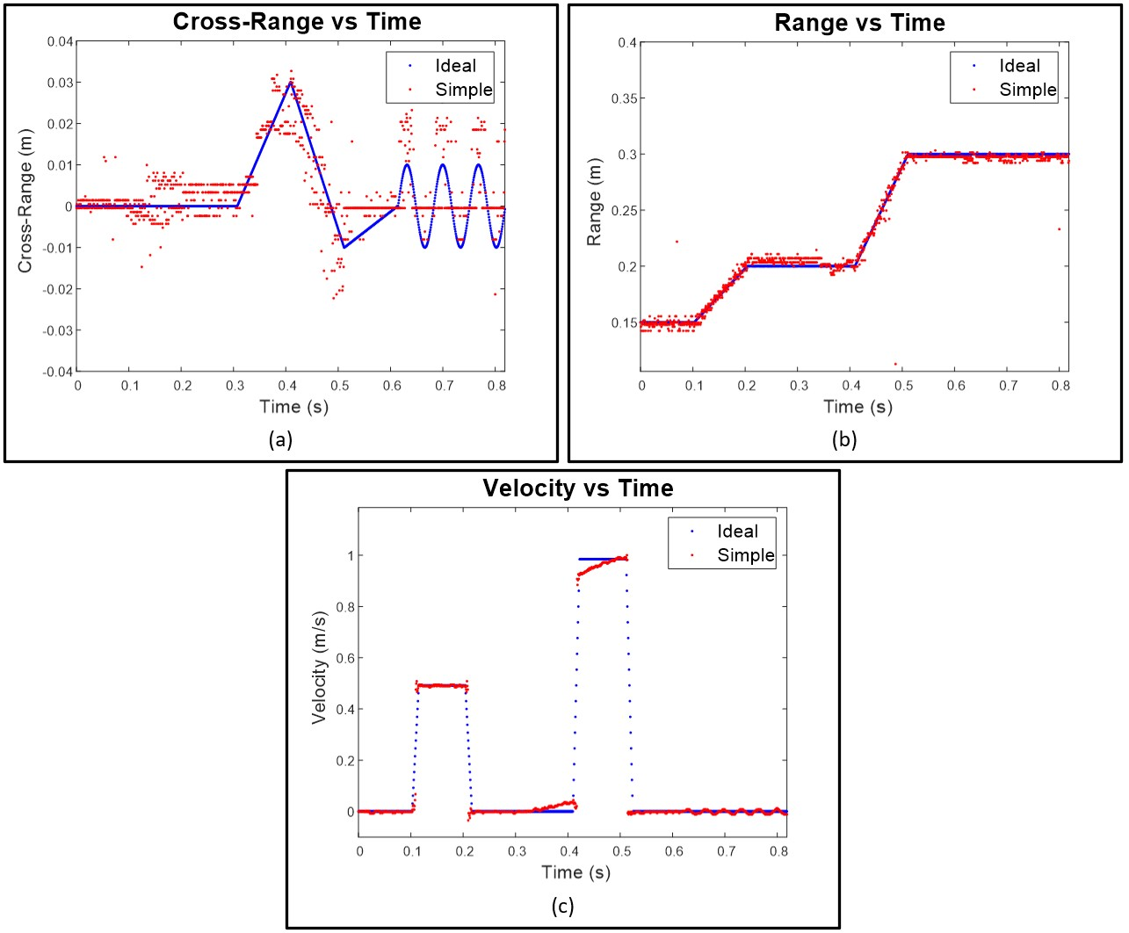
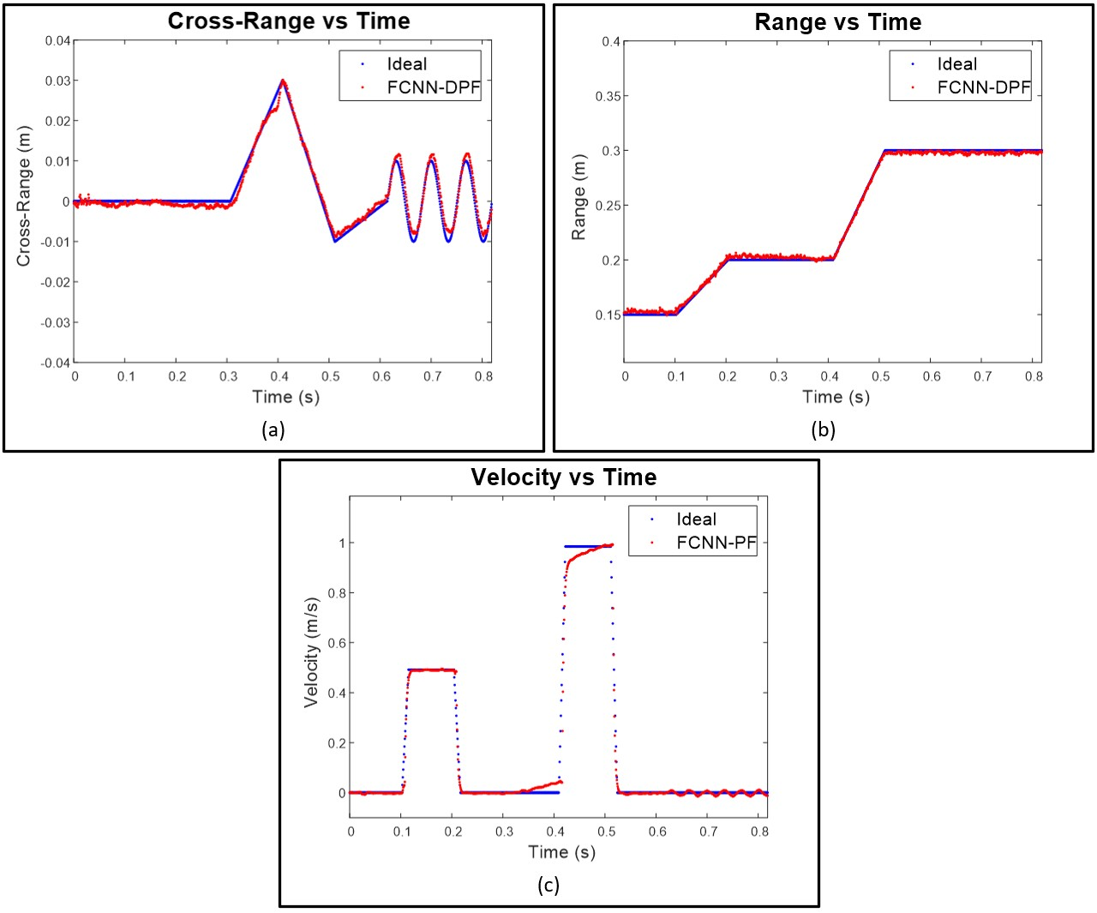
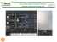
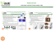
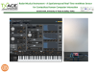

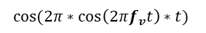
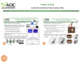
Radar Musical Instrument - A Spatiotemporal Real-Time mmWave Sensor for Contactless Human-Computer Interaction Josiah Smith, University of Texas at Dallas, TxACE
OBJECTIVE: Design non-contact musical interface using mmWave sensors and novel computer vision algorithms.
APPROACH: Develop real-time spatiotemporal signal processing chain utilizing novel machine learning and computer vision algorithms to extract spatial and temporal features of the musician’s hand from the radar beat signal.
Mapping location and movement to music
Range, cross-range oscillation rate, Doppler velocity
Super-resolution FCNN improves localization
Novel Doppler-corroborated particle filter algorithm increases tracking performance
RESULTS: High-throughput feature extraction, deep-learning enhancement, and robust tracking algorithms enable acute control of the Radar Musical Instrument and demonstrate the proficiency of mmWave technology for hand gesture tracking.
Enhancement FCNN
$$f_{v}$$
$$cos⁡(2π∗cos\left(2πf_{v}t\right)∗t)$$
Particle Filter

Slide 2
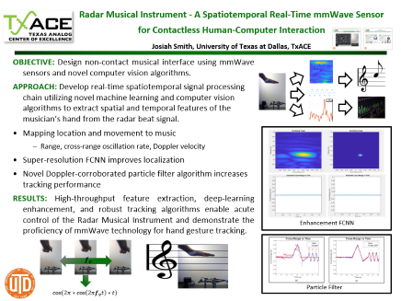
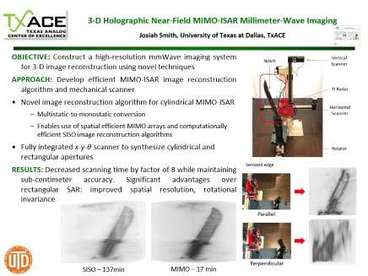

Posters 25 & 26 Josiah Smith, University of Texas at Dallas, TxACE

Slide 3
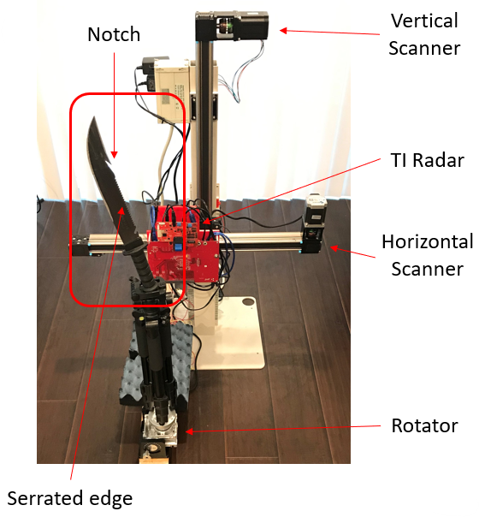
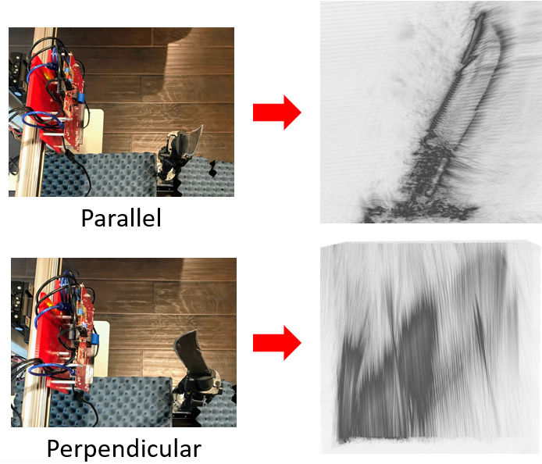
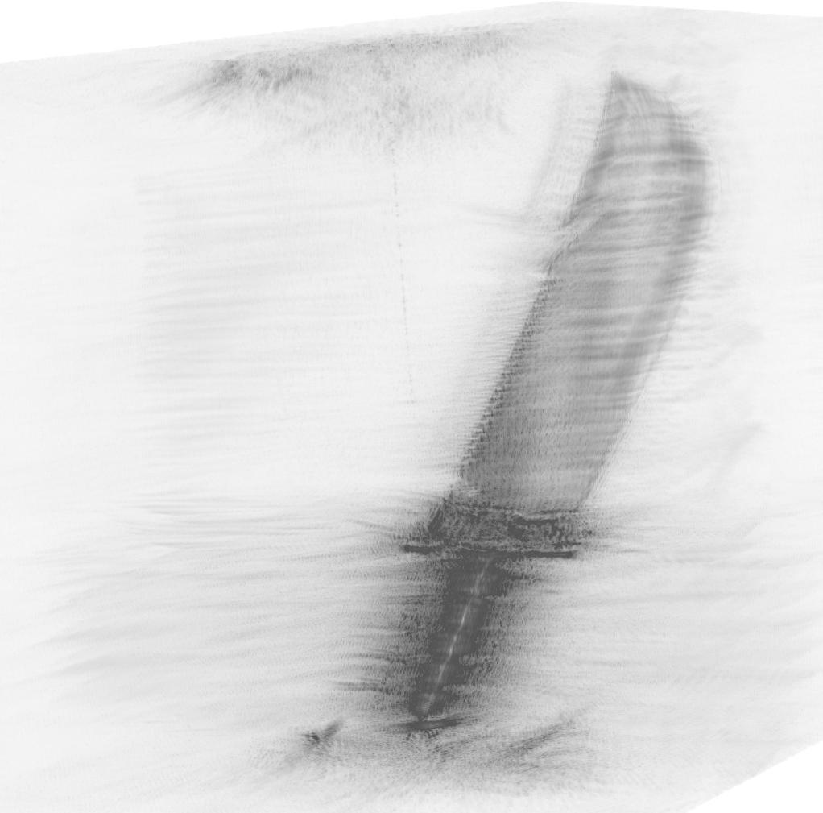
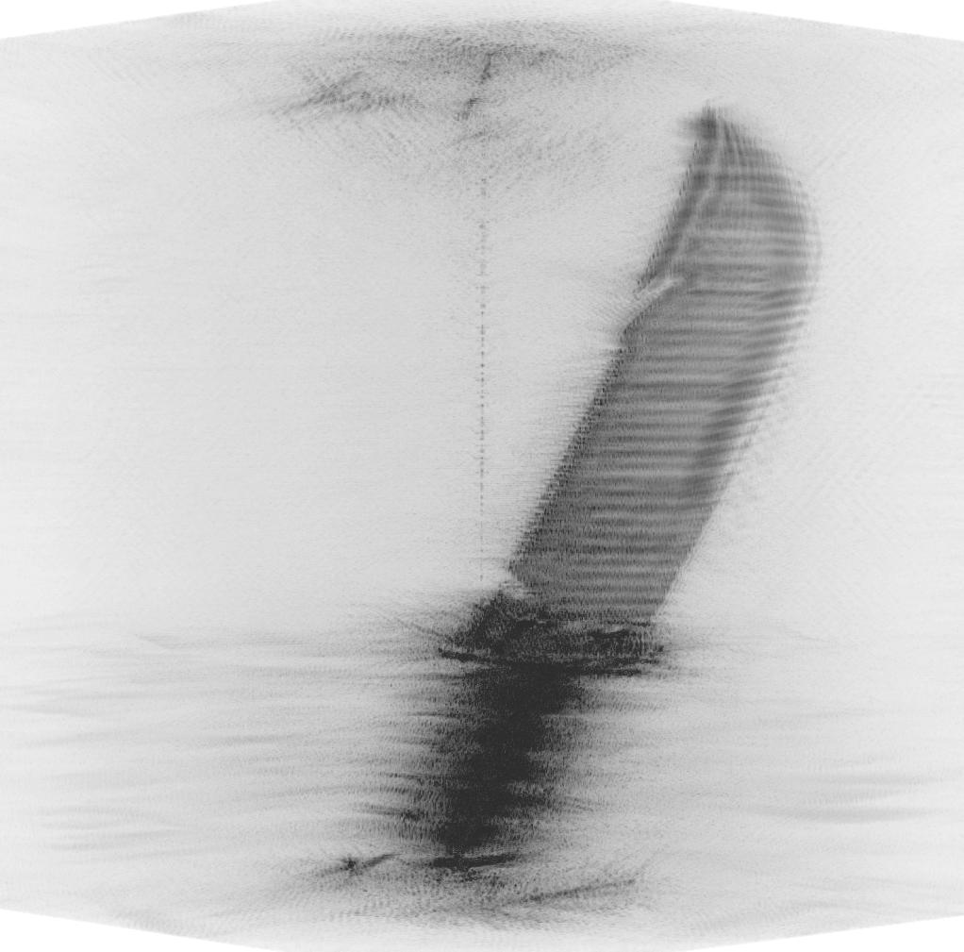

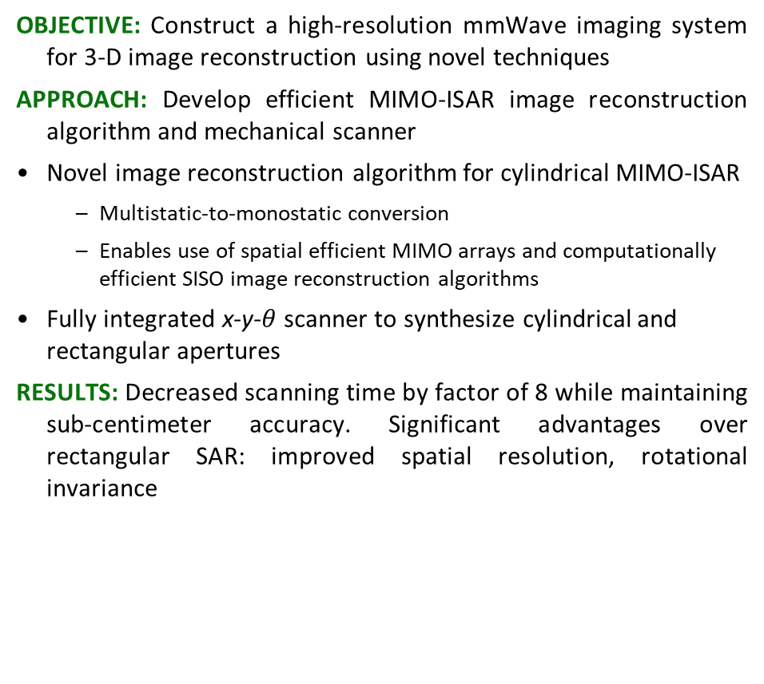
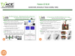
3-D Holographic Near-Field MIMO-ISAR Millimeter-Wave Imaging Josiah Smith, University of Texas at Dallas, TxACE
OBJECTIVE: Construct a high-resolution mmWave imaging system for 3-D image reconstruction using novel techniques
APPROACH: Develop efficient MIMO-ISAR image reconstruction algorithm and mechanical scanner
Novel image reconstruction algorithm for cylindrical MIMO-ISAR
Multistatic-to-monostatic conversion
Enables use of spatial efficient MIMO arrays and computationally efficient SISO image reconstruction algorithms
Fully integrated x-y-$θ$ scanner to synthesize cylindrical and rectangular apertures
RESULTS: Decreased scanning time by factor of 8 while maintaining sub-centimeter accuracy. Significant advantages over rectangular SAR: improved spatial resolution, rotational invariance
SISO – 137min
MIMO – 17 min

Slide 4
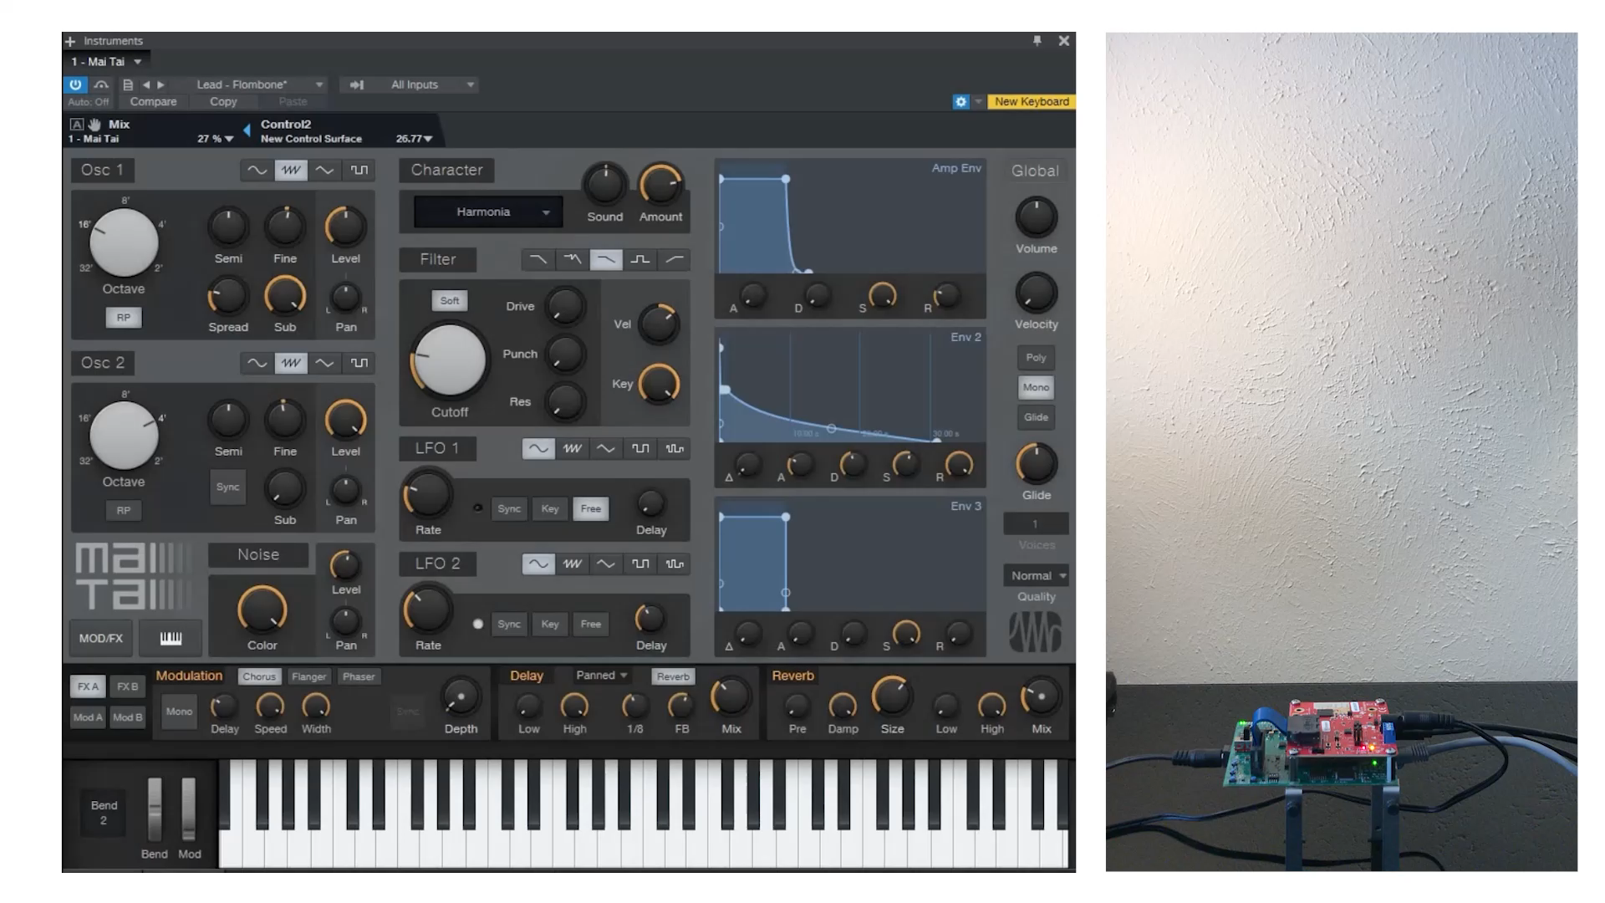
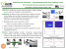

Radar Musical Instrument - A Spatiotemporal Real-Time mmWave Sensor for Contactless Human-Computer Interaction Josiah Smith, University of Texas at Dallas, TxACE

